Slide 1

CERTIFICATE III IN AUTOMOTIVE REPAIR & MAINTENANCE
SUBJECT: VEHICLE MAINTENACE AND REPAIR
By Ibrahim siraj
Maldives polytechnic

Slide 2
VEHICLE MAINTENACE AND REPAIR
Chapter 10 Inspection and Service Manual Transmission
Introduction
Manual Transmission in Cars Manual transmission cars require the driver to actively shift gears using a clutch pedal and a gear stick, sometimes called a "stick shift". They offer advantages like better fuel efficiency and potentially simpler maintenance, and are available on a wide range of 2025 models from brands like BMW, Porsche, Mazda, and Honda.
How they work
A manual transmission requires the driver to use a clutch pedal and a gear shift lever to change gears
.
The driver is responsible for choosing the correct gear for the vehicle's speed and for shifting as they accelerate or decelerate
By Ibrahim siraj
Maldives polytechnic

Slide 3
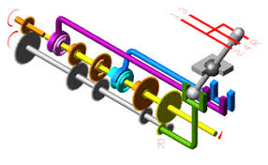
VEHICLE MAINTENACE AND REPAIR
Chapter 10 Inspection and Service Manual Transmission
How it works
Clutch pedal: The left-most pedal, which the driver presses to disengage the engine from the transmission, allowing them to shift gears.
Gear shift lever: A stick on the center console that the driver moves to select the desired gear (e.g., 1st, 2nd, 3rd, etc.)
Shifting process: To shift, the driver must:
Press the clutch pedal down.
Move the gear shift lever to the new gear.
Slowly release the clutch pedal while simultaneously applying gas to smoothly transition to the new gear
By Ibrahim siraj
Maldives polytechnic

Slide 4
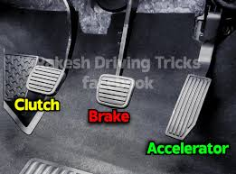
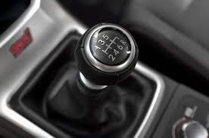
VEHICLE MAINTENACE AND REPAIR
Chapter 10 Inspection and Service Manual Transmission
Driver Experience
Driving a manual car is often seen as more engaging, as it provides a stronger connection between the driver and the machine.
While it requires more practice and coordination, mastering the skill can be satisfying for many drivers
By Ibrahim siraj
Maldives polytechnic

Slide 5
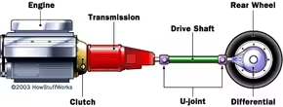
VEHICLE MAINTENACE AND REPAIR
Chapter 10 Inspection and Service Manual Transmission
Continuously Variable Transmissions (CVT)
A continuously variable transmission (CVT) has a nearly infinite range of gear ratios. In the past, CVTs could not compete with four-speed and five-speed transmissions in terms of cost, size and reliability, so you didn't see them in production automobiles.
By Ibrahim siraj
Maldives polytechnic

Slide 6
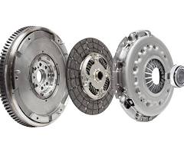
VEHICLE MAINTENACE AND REPAIR
Chapter 10 Inspection and Service Manual Transmission
Basic Parts of a Manual Transmission
Clutch
Gearbox
Shafts
Gears
Shift Mechanism
Clutch: Connects and disconnects the engine from the transmission, allowing you to change gears without grinding
By Ibrahim siraj
Maldives polytechnic

Slide 7
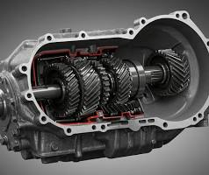
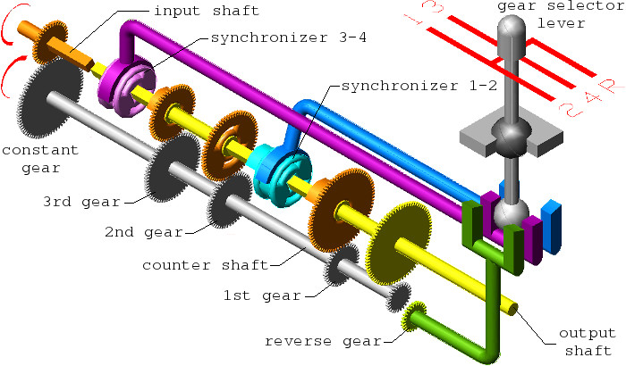
VEHICLE MAINTENACE AND REPAIR
Chapter 10 Inspection and Service Manual Transmission
Basic Parts of a Manual Transmission
Gearbox: The case that houses the internal components, including the gears, shafts, and bearings
Shafts:
Input Shaft: Receives power from the engine via the clutch and flywheel.
Output Shaft: Transfers power from the transmission to the wheels.
Countershaft (or Layshaft): A shaft that holds gears and transfers power between the input and output shafts
By Ibrahim siraj
Maldives polytechnic

Slide 8
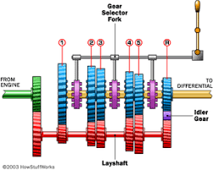
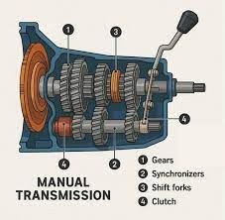
VEHICLE MAINTENACE AND REPAIR
Chapter 10 Inspection and Service Manual Transmission
Basic Parts of a Manual Transmission
Gears: Different-sized gears are mounted on the shafts, and their engagement at various ratios determines the vehicle's speed and torque.
Shift Mechanism:
Gear Shift Lever (Stick Shift): The lever the driver uses to select a gear.
Shift Forks: Move the synchronizer rings to engage the chosen gear.
Synchronizers: Devices that match the speed of the gears and the collar before they lock together, preventing grinding and ensuring smooth shifting
By Ibrahim siraj
Maldives polytechnic

Slide 9
VEHICLE MAINTENACE AND REPAIR
Chapter 10 Inspection and Service Manual Transmission
How it works
Depress the clutch: The driver pushes the clutch pedal down to disengage the engine from the transmission.
Move the shift lever: The driver moves the shift lever to the desired gear position.
Linkage moves the fork: The shift lever's movement activates the linkage to push the correct shift fork.
Collar engages the gear: The shift fork pushes the synchronizer collar, which slides along the shaft.
Synchronization: Before locking, the synchronizer ring (part of the collar) frictionally matches the speed of the free-spinning gear to the speed of the output shaft.
Gear engagement: Once the speeds are synchronized, the collar slides further to lock onto the gear's teeth, making the gear a single unit with the output shaft.
Release the clutch: The driver releases the clutch to transfer power from the engine through the newly selected gear
By Ibrahim siraj
Maldives polytechnic

Slide 10
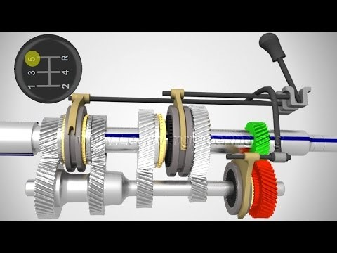
VEHICLE MAINTENACE AND REPAIR
Chapter 10 Inspection and Service Manual Transmission
Manual Transmission
By Ibrahim siraj
Maldives polytechnic

Slide 11
VEHICLE MAINTENACE AND REPAIR
Chapter 10 Inspection and Service Manual Transmission
Manual Transmission Gear Ratios
Gear Ratio Principles
Calculation: A gear ratio is calculated by dividing the number of teeth on the driven gear by the number of teeth on the driving gear (Ratio = Driven ÷ Drive).
Torque vs. Speed: A gear ratio greater than 1:1 is a gear reduction (underdrive), which increases torque but decreases speed. A gear ratio less than 1:1 is an overdrive, which increases speed but decreases torque.
Overall Ratio: The final overall gear ratio for the wheels includes both the transmission's individual gear ratio and the final drive ratio in the differential. The overall ratio for a specific gear is the product of its transmission ratio and the final drive ratio.
By Ibrahim siraj
Maldives polytechnic

Slide 12
VEHICLE MAINTENACE AND REPAIR
Chapter 10 Inspection and Service Manual Transmission
Typical Gear Ratios (5-Speed Manual)
Typical manual transmissions feature a progression of gear ratios designed to optimize performance across different driving conditions. Below are common examples:
Gear | Typical Ratio | Purpose
1st Gear | ~3.0:1 to 4.0:1 | Provides maximum torque for starting from a standstill or climbing steep hills.
2nd Gear | ~1.8:1 to 2.5:1 | Offers a balance of torque and speed for moderate acceleration.
3rd Gear | ~1.2:1 to 1.5:1 | Suitable for city driving and maintaining speed on flat roads.
4th Gear | ~1.0:1 (Direct Drive) to 1.2:1 | Often a 1:1 direct drive ratio in 4-speed or some 5-speed transmissions, where the input and output shafts spin at the same speed.
5th Gear (Overdrive) | ~0.7:1 to 0.9:1 | An overdrive gear designed for high speeds with reduced engine RPM, improving fuel efficiency during highway cruising.
Reverse | ~3.0:1 to 4.0:1 | Uses an idler gear to reverse the direction of rotation, offering high torque for moving backward.
Final Drive | ~3.5:1 to 4.5:1 | An additional reduction in the differential that multiplies the transmission's output torque before it reaches the wheels
By Ibrahim siraj
Maldives polytechnic

Slide 13
VEHICLE MAINTENACE AND REPAIR
Chapter 10 Inspection and Service Manual Transmission
Typical Gear Ratios (5-Speed Manual)
Manual transmissions are most commonly found in sports cars, enthusiast vehicles, and trucks, though they are becoming less common in new models. Examples include the Ford Mustang, Mazda Miata, Subaru BRZ, Toyota GR86, Toyota Tacoma, and Jeep Wrangler. They offer drivers a greater sense of control over the vehicle
Sports cars and enthusiast vehicles
Acura: Integra, Integra Type S
BMW: M2, M3, M4, Z4
Cadillac: CT4-V, CT5-V
Honda: Civic Si, Civic Type R
Lotus: Emira
Mazda: 3 Hatchback, Miata
Nissan: Z
Porsche: 718 Boxster and Cayman, 911
Subaru: BRZ, WRX
Toyota: GR86, GR Corolla, GR Supr
By Ibrahim siraj
Maldives polytechnic

Slide 14
VEHICLE MAINTENACE AND REPAIR
Chapter 10 Inspection and Service Manual Transmission
Typical Gear Ratios (5-Speed Manual)
Gear Change Approx. Speed Tachometer RPM Upshifting
1 st – 2 nd 15 mph 2,000 – 3,000
2 nd – 3 rd 25 mph 2,500 – 3,500
3 rd – 4 th 40 mph 2,500 – 3,500
4 th – 5 th 50 mph 2,500 – 3,500
Downshifting
5 th – 4 th 40 mph 2,000
4 th – 3 rd 30 mph 2,000
3 rd – 2 nd 20 mph 2,000
2 nd – 1 st 10 mph 1,500
By Ibrahim siraj
Maldives polytechnic

Slide 15
THANK YOU

